Slide 1
Dynamic Query form for Database Queries
PROJECT BY:
Aishwarya Jain 13CMPN15
Viraj Patil 13CMPN44
Aishwarya Shah 13CMPN52
Vaibhav Upadhyay 13CMPN59

Slide 2
Problem Statement
To build a dynamic query form interface by capturing users preferences and rank query form components.

Slide 3
Problem Description:
Modern scientific databases and web databases maintain large and heterogeneous data. These real-world databases contain over hundreds or even thousands of relations and attributes. Traditional predefined query forms are not able to satisfy various ad-hoc queries from users on those databases. This paper proposes DQF, a novel database query form interface, which is able to dynamically generate query forms. The essence of DQF is to capture user’s preference and rank query form components, assisting him/her to make decisions. The generation of a query form is an iterative process and is guided by the user. At each iteration, the system automatically generates ranking lists of form components and the user then adds the desired form components into the query form. The ranking of form components is based on the captured user preference. A user can also fill the query form and submit queries to view the query result at each iteration. In this way, a query form could be dynamically renewed till the user satisfies with the query results.

Slide 4
Purpose:
How to let non-expert users make use of the relational database is a challenging topic. A lot of research works focus on database interfaces which assist users to query the relational database without SQL. We propose a dynamic query form system which generates the query forms according to the user’s desire at run time. The system provides a solution for the query interface in large and complex databases.

Slide 5
Scope:
This system in software requirement specification is designed to let a non-expert user interact with the database for retrieval of data according to his/her need and his/her preferences. While the proposed system will assist him/her to make decisions.

Slide 6
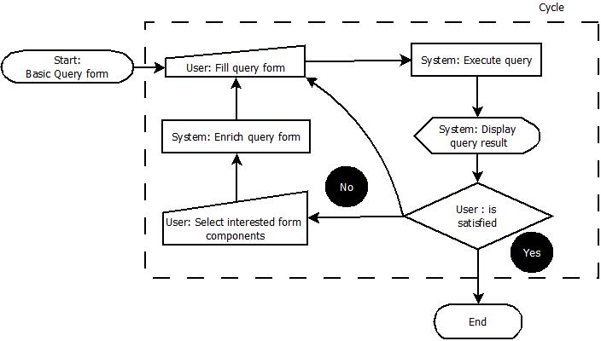
Product Perspective
Flowchart Diagram :

Slide 7
Requirements:
Software Requirements
Visual Studio 2015
Libraries Used: FontAwesome, Bootstrap
Language Used: HTML, CSS, Asp .Net, C# .
Hardware Requirements[Minimum]:
Intel Core 2 Duo @2.83 GHz
80 GB HDD
1 GB RAM

Slide 8
Product Functions:
1. Keyword search with Query form generation
In the future it creates good deal of query forms. The user has to provide some keywords get the query forms from the large databases. The database that contains information in the form of rich text as data schemas and tuples works well. Again we can understand one difficulty with this user doesn’t have appropriate keywords to start.
2. Query Form Enrichment
1)DQF recommends a ranked list of query form components to the user.
2) The user selects the desired form components into the current query form.

Slide 9
Product Functions:
3. Query execution
1) The user fills out the current query form and submit a query.
2) DQF executes the query and shows the results.
3) The user provides the feedback about the query results.
4. Customized Query Form
They provide visual interfaces for developers to create or customize query forms. The problem of those tools is that, they are provided for the professional developers who are familiar with their databases, not for end-users. If proposed a system which allows end-users to customize the existing query form at run time. However, an end-user may not be familiar with the database. If the database schema is very large, it is difficult for them to find appropriate database entities and attributes and to create desired query forms.

Slide 10
Product Functions:
5. Database Query Recommendation
Recent studies introduce collaborative approaches to recommend database query components for database exploration. They treat SQL queries as items in the collaborative filtering approach, and recommend similar queries to related users

Slide 11
SPECIFIC REQUIREMENTS
External Interface:
Input: The input will be in the form of keyword as the user preferences and his/her requirements. Also the keyword may be from ranked components as assisted by the system.
Output: Output will be the result of query as refined by the user.

Slide 12
SPECIFIC REQUIREMENTS
Functional Requirements:
The system is proposed to have the following modules along with functional requirements.
Query Form Enrichment
Query Execution
Customized Query Form
Database Query Recommendation

Slide 13
SPECIFIC REQUIREMENTS
Performance Requirements:
The system is proposed to have the following performance requirements :
The system should provide ranked components to assist user to make him/her decisions.
The system should provide security to the user databases and assign roles to users.
The user selected query must provide instantaneous results.

Slide 14
SPECIFIC REQUIREMENTS
Software system attributes:
There are a number of attributes of software that can serve as requirements. It is important that required attributes be specified so that their achievement can be objectively verified.
Reliability
The query results will be accurate and will be totally based on user preferences and ranking algorithm
Security
The database and its data retrieval will be available for authorized users only.
Availability
The system will be available as a web-application.

Slide 15
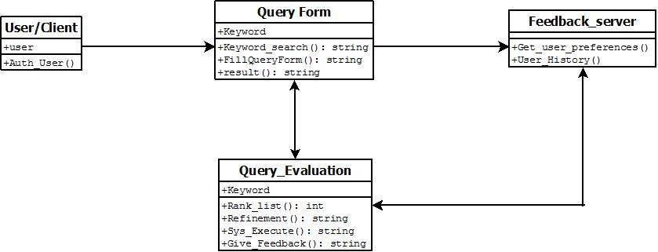
SOFTWARE DESIGN DOCUMENT
CLASS Diagram

Slide 16
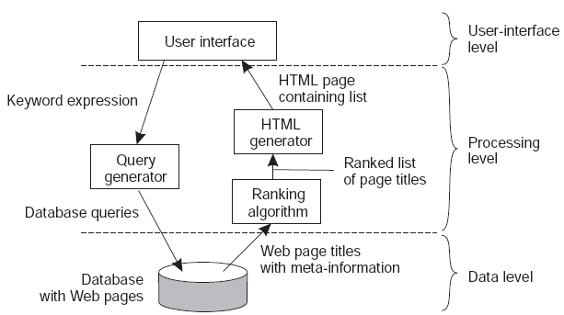
SOFTWARE DESIGN DOCUMENT
Structural Design:

Slide 17
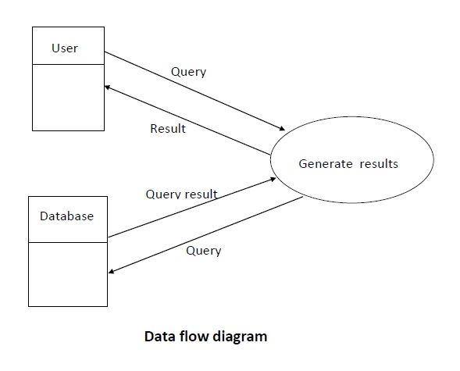
SOFTWARE DESIGN DOCUMENT
Data Flow Diagram

Slide 18
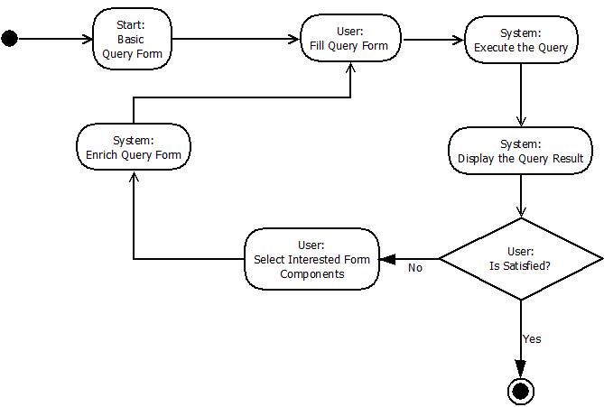
SOFTWARE DESIGN DOCUMENT
Activity Diagram

Slide 19
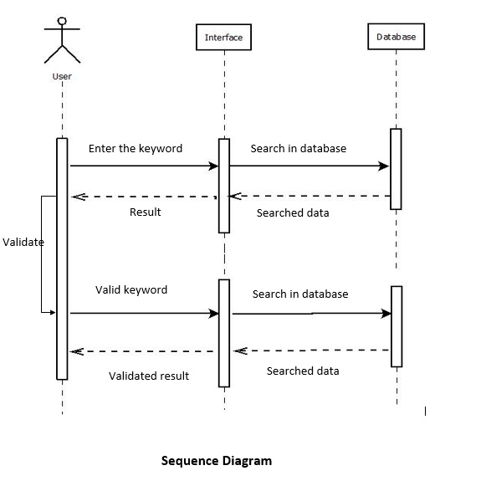
SOFTWARE DESIGN DOCUMENT
Sequence diagram

Slide 20
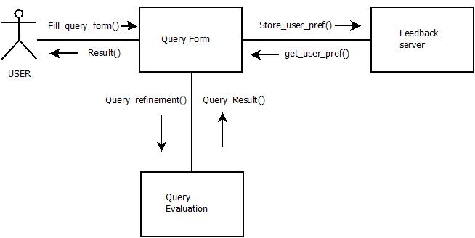
SOFTWARE DESIGN DOCUMENT
Collabration diagram

Slide 21
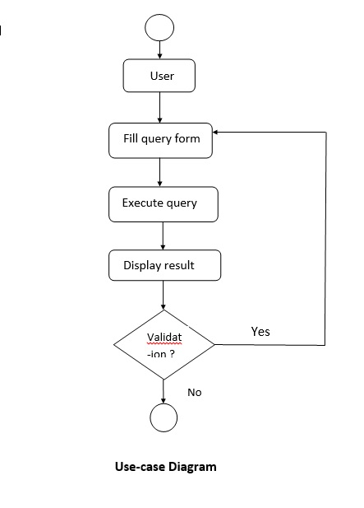
SOFTWARE DESIGN DOCUMENT
UseCase diagram

Slide 22
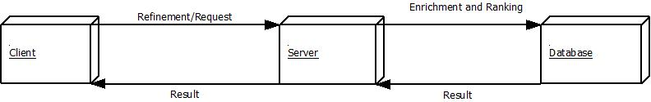
SOFTWARE DESIGN DOCUMENT
Deployment diagram

Slide 23
TESTING, COSTING AND MEMBERS
5.1 Testing:
Testing the query form interface with provided database
Testing the results are accurate and based on the ranking algorithm.
5.2 Costing:
Estimated hardware cost will be approx. 5000/-
5.3 Members:
Maximum 5 members are required in this project.

Slide 24
References
S. Agrawal, S. Chaudhuri, G. Das, and A. Gionis, “Automated ranking of database query results, ” in Proc. CIDR, 2003, pp. 888–899
C. C. Aggarwal, J. Han, J. Wang, and P. S. Yu, “A framework for clustering evolving data streams,” in Proc. VLDB, Berlin, Germany, Sept. 2003, pp. 81– 92.
M. Jayapandian and H. V. Jagadish, “Automated creation of a forms-based database query interface,” Proc. VLDB, vol. 1, no. 1, Aug. 2008, pp. 695–709.
M. Jayapandian and H. V. Jagadish, “Automating the design and construction of query forms,” IEEE Trans. Knowl. Data Eng., vol. 21, no. 10, Oct. 2009, pp. 1389–1402.
E. Chu, A. Baid, X. Chai, A. Doan, and J. F. Naughton, “Combining keyword search and forms for ad hoc querying of databases,” in Proc. ACM SIGMOD, Providence, RI, USA, Jun. 2009, pp. 349– 360.
.

